Slide 1

INPUT DEVICES
Sends information to a computer system
STUDENT NAME : L.H.G. YASIRU PRABODHA
STUDENT NUMBER : CL/OTHMFL3/11/90

Slide 2

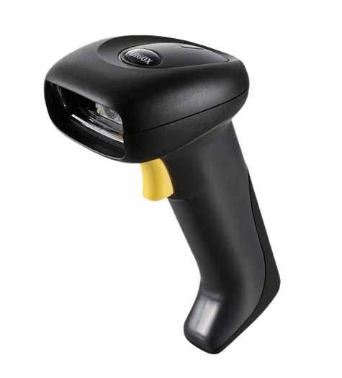
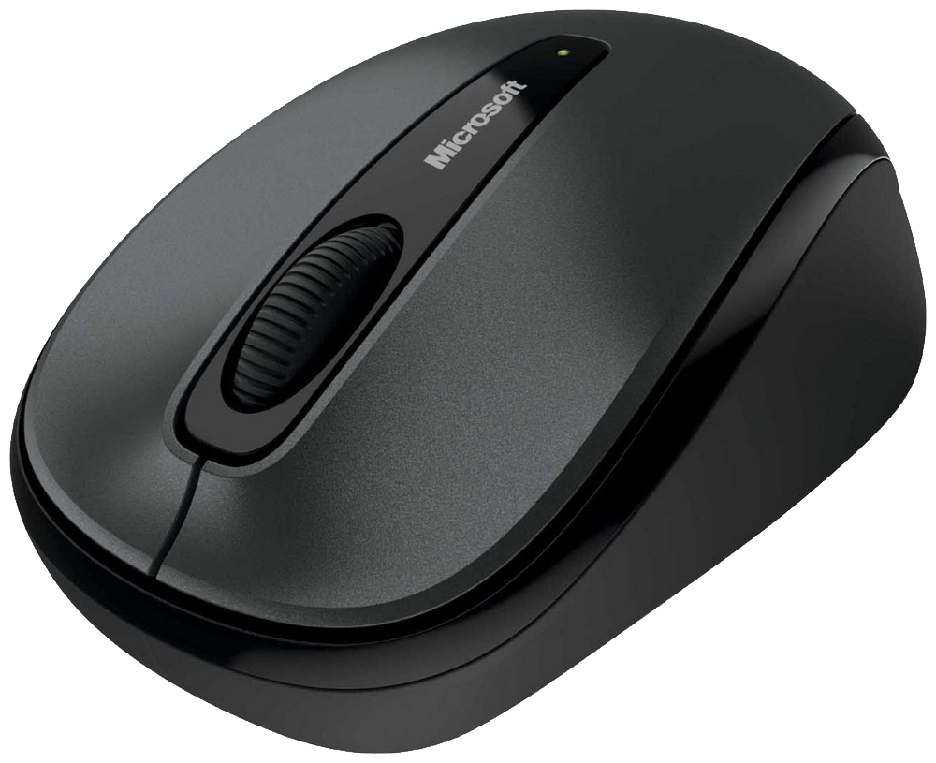
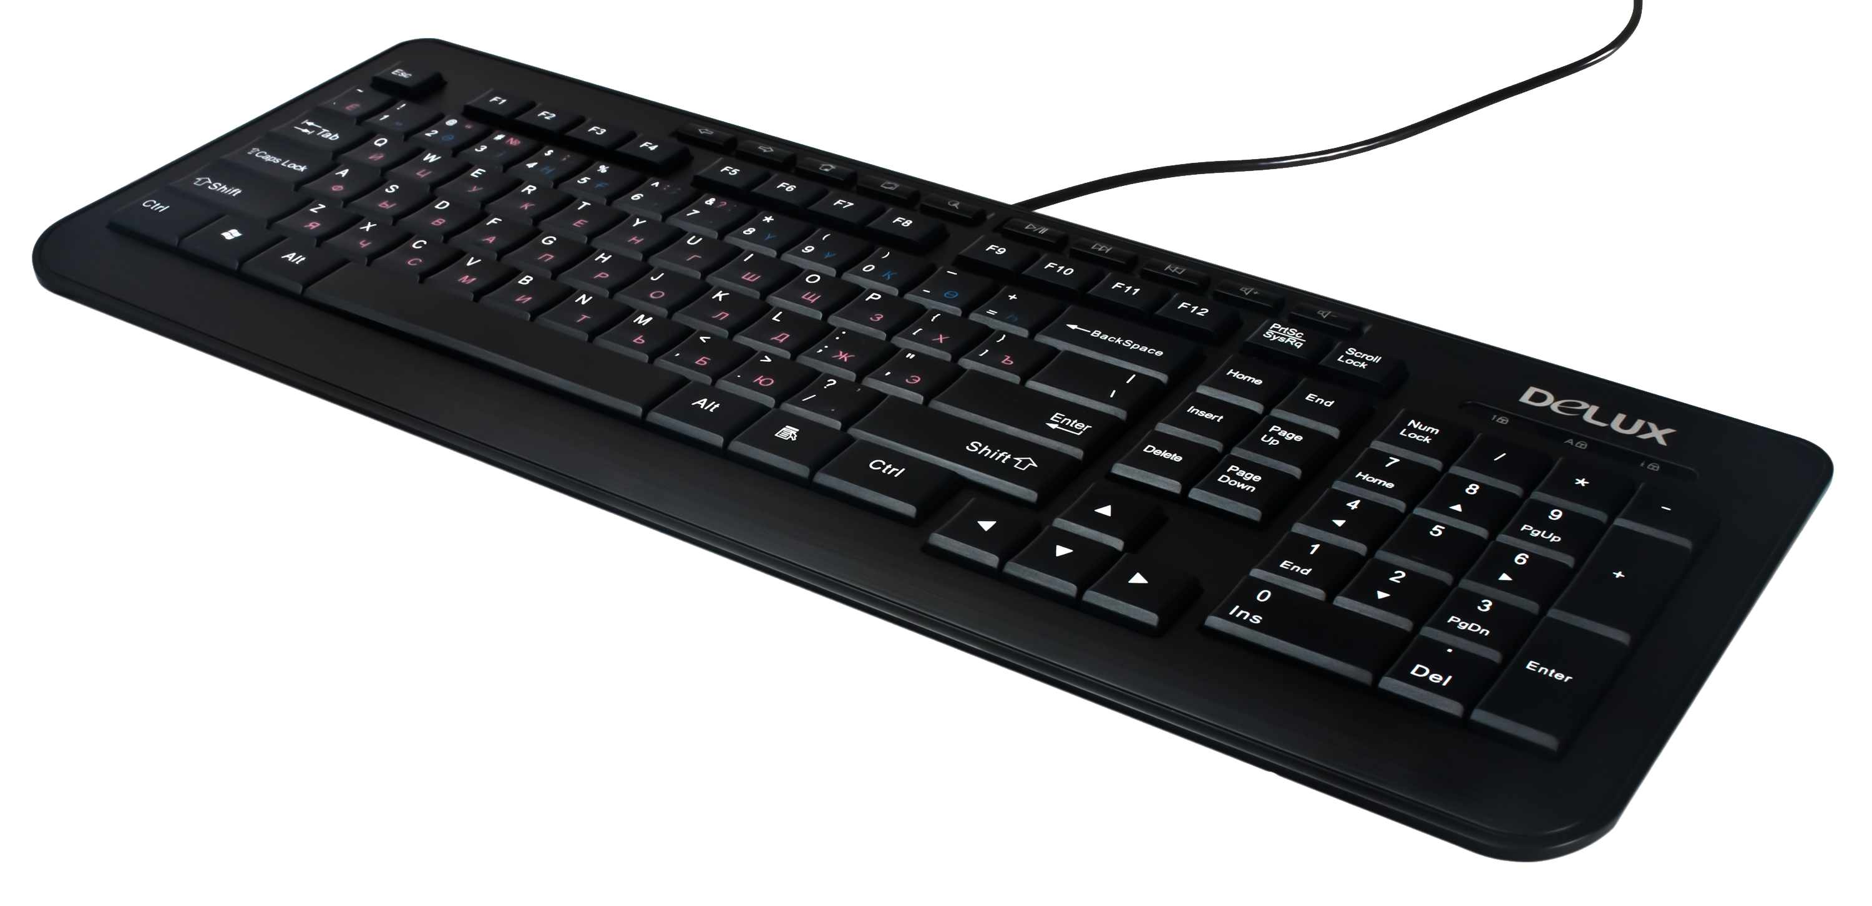
Introduction
Computer cannot understanding our language because it understands only machine language and it can be possible using some devices are called input devices.
When we work with computer we need to enter data and instructions to the computer using these devices.
These devices convert data and instructions to a form that can be recognized by the computer.

Slide 3

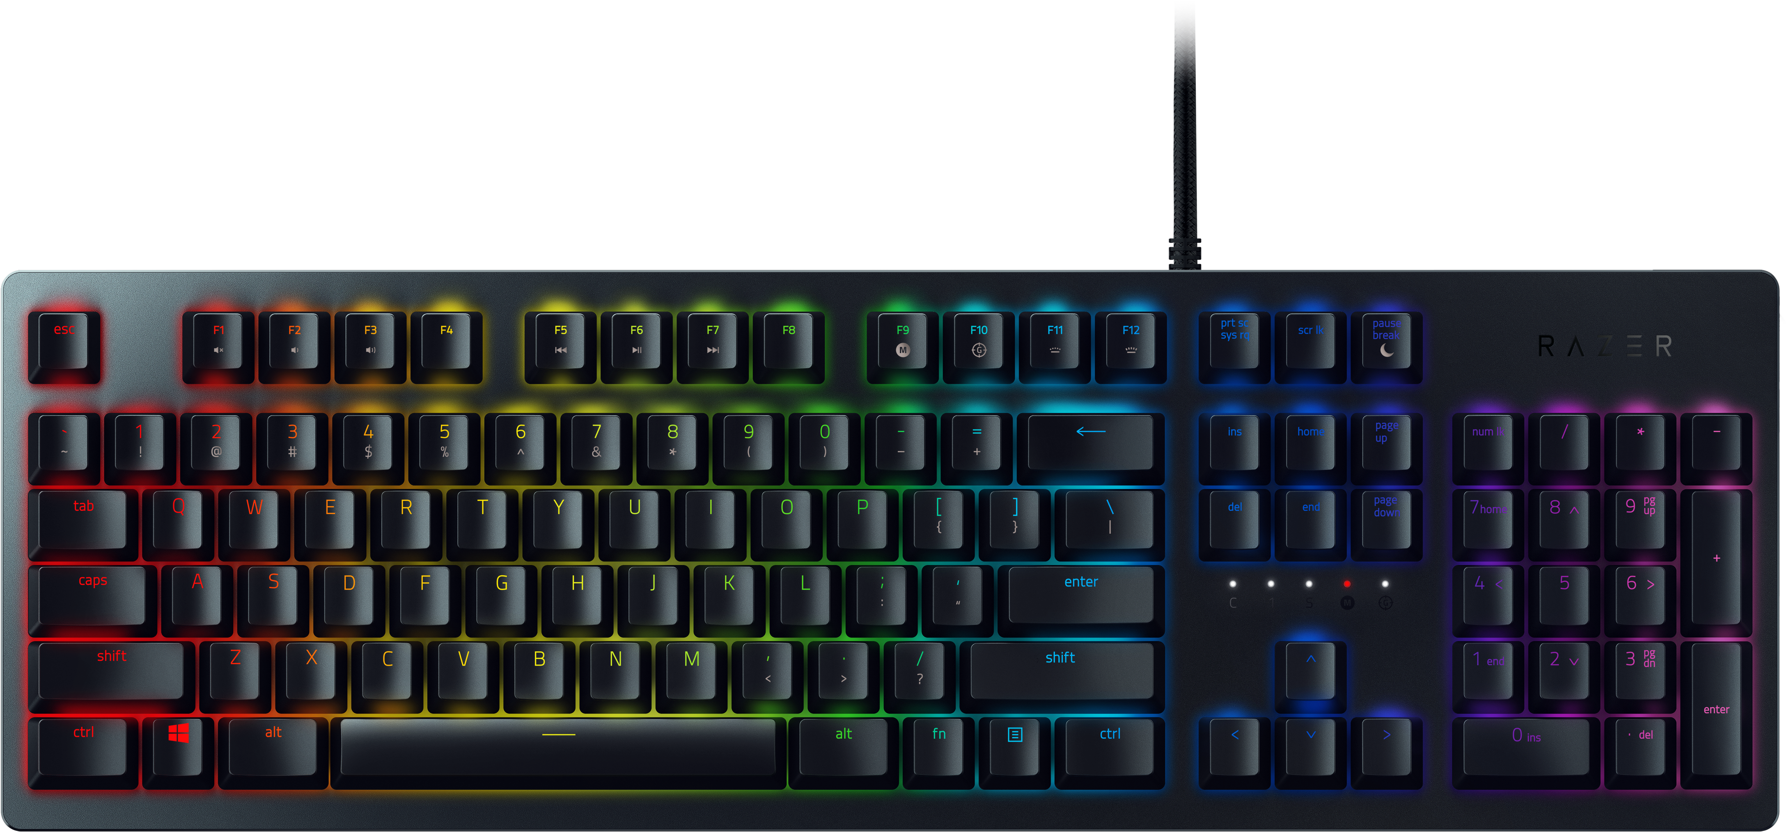
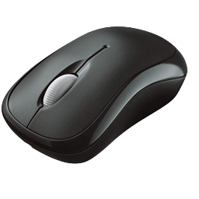
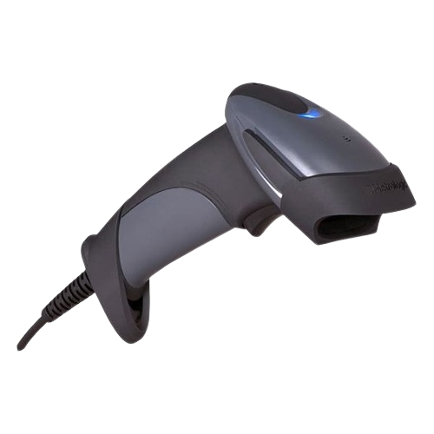
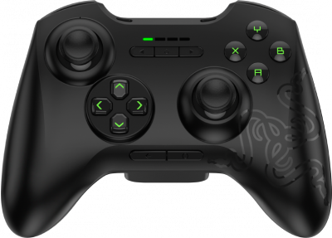
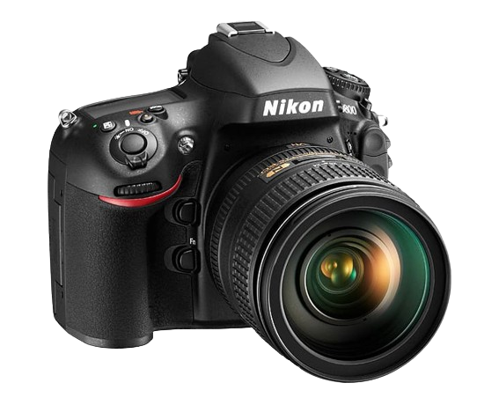
Types Of Input Devices
KEYBOARD
MOUSE
SCANNER
Input
JOYSTICK
DIGITAL CAMERA

Slide 4

Most Used Input Devices
01
KEYBOARD
The keyboard, with its layout of keys, allows users to input text, numbers, and special characters. It's an indispensable tool for activities ranging from word processing to coding.
02
MOUSE
The mouse, with its pointing and clicking capabilities, provides a convenient means of navigating graphical user interfaces. It is an essential companion to the keyboard, enhancing user control and productivity.

Slide 5
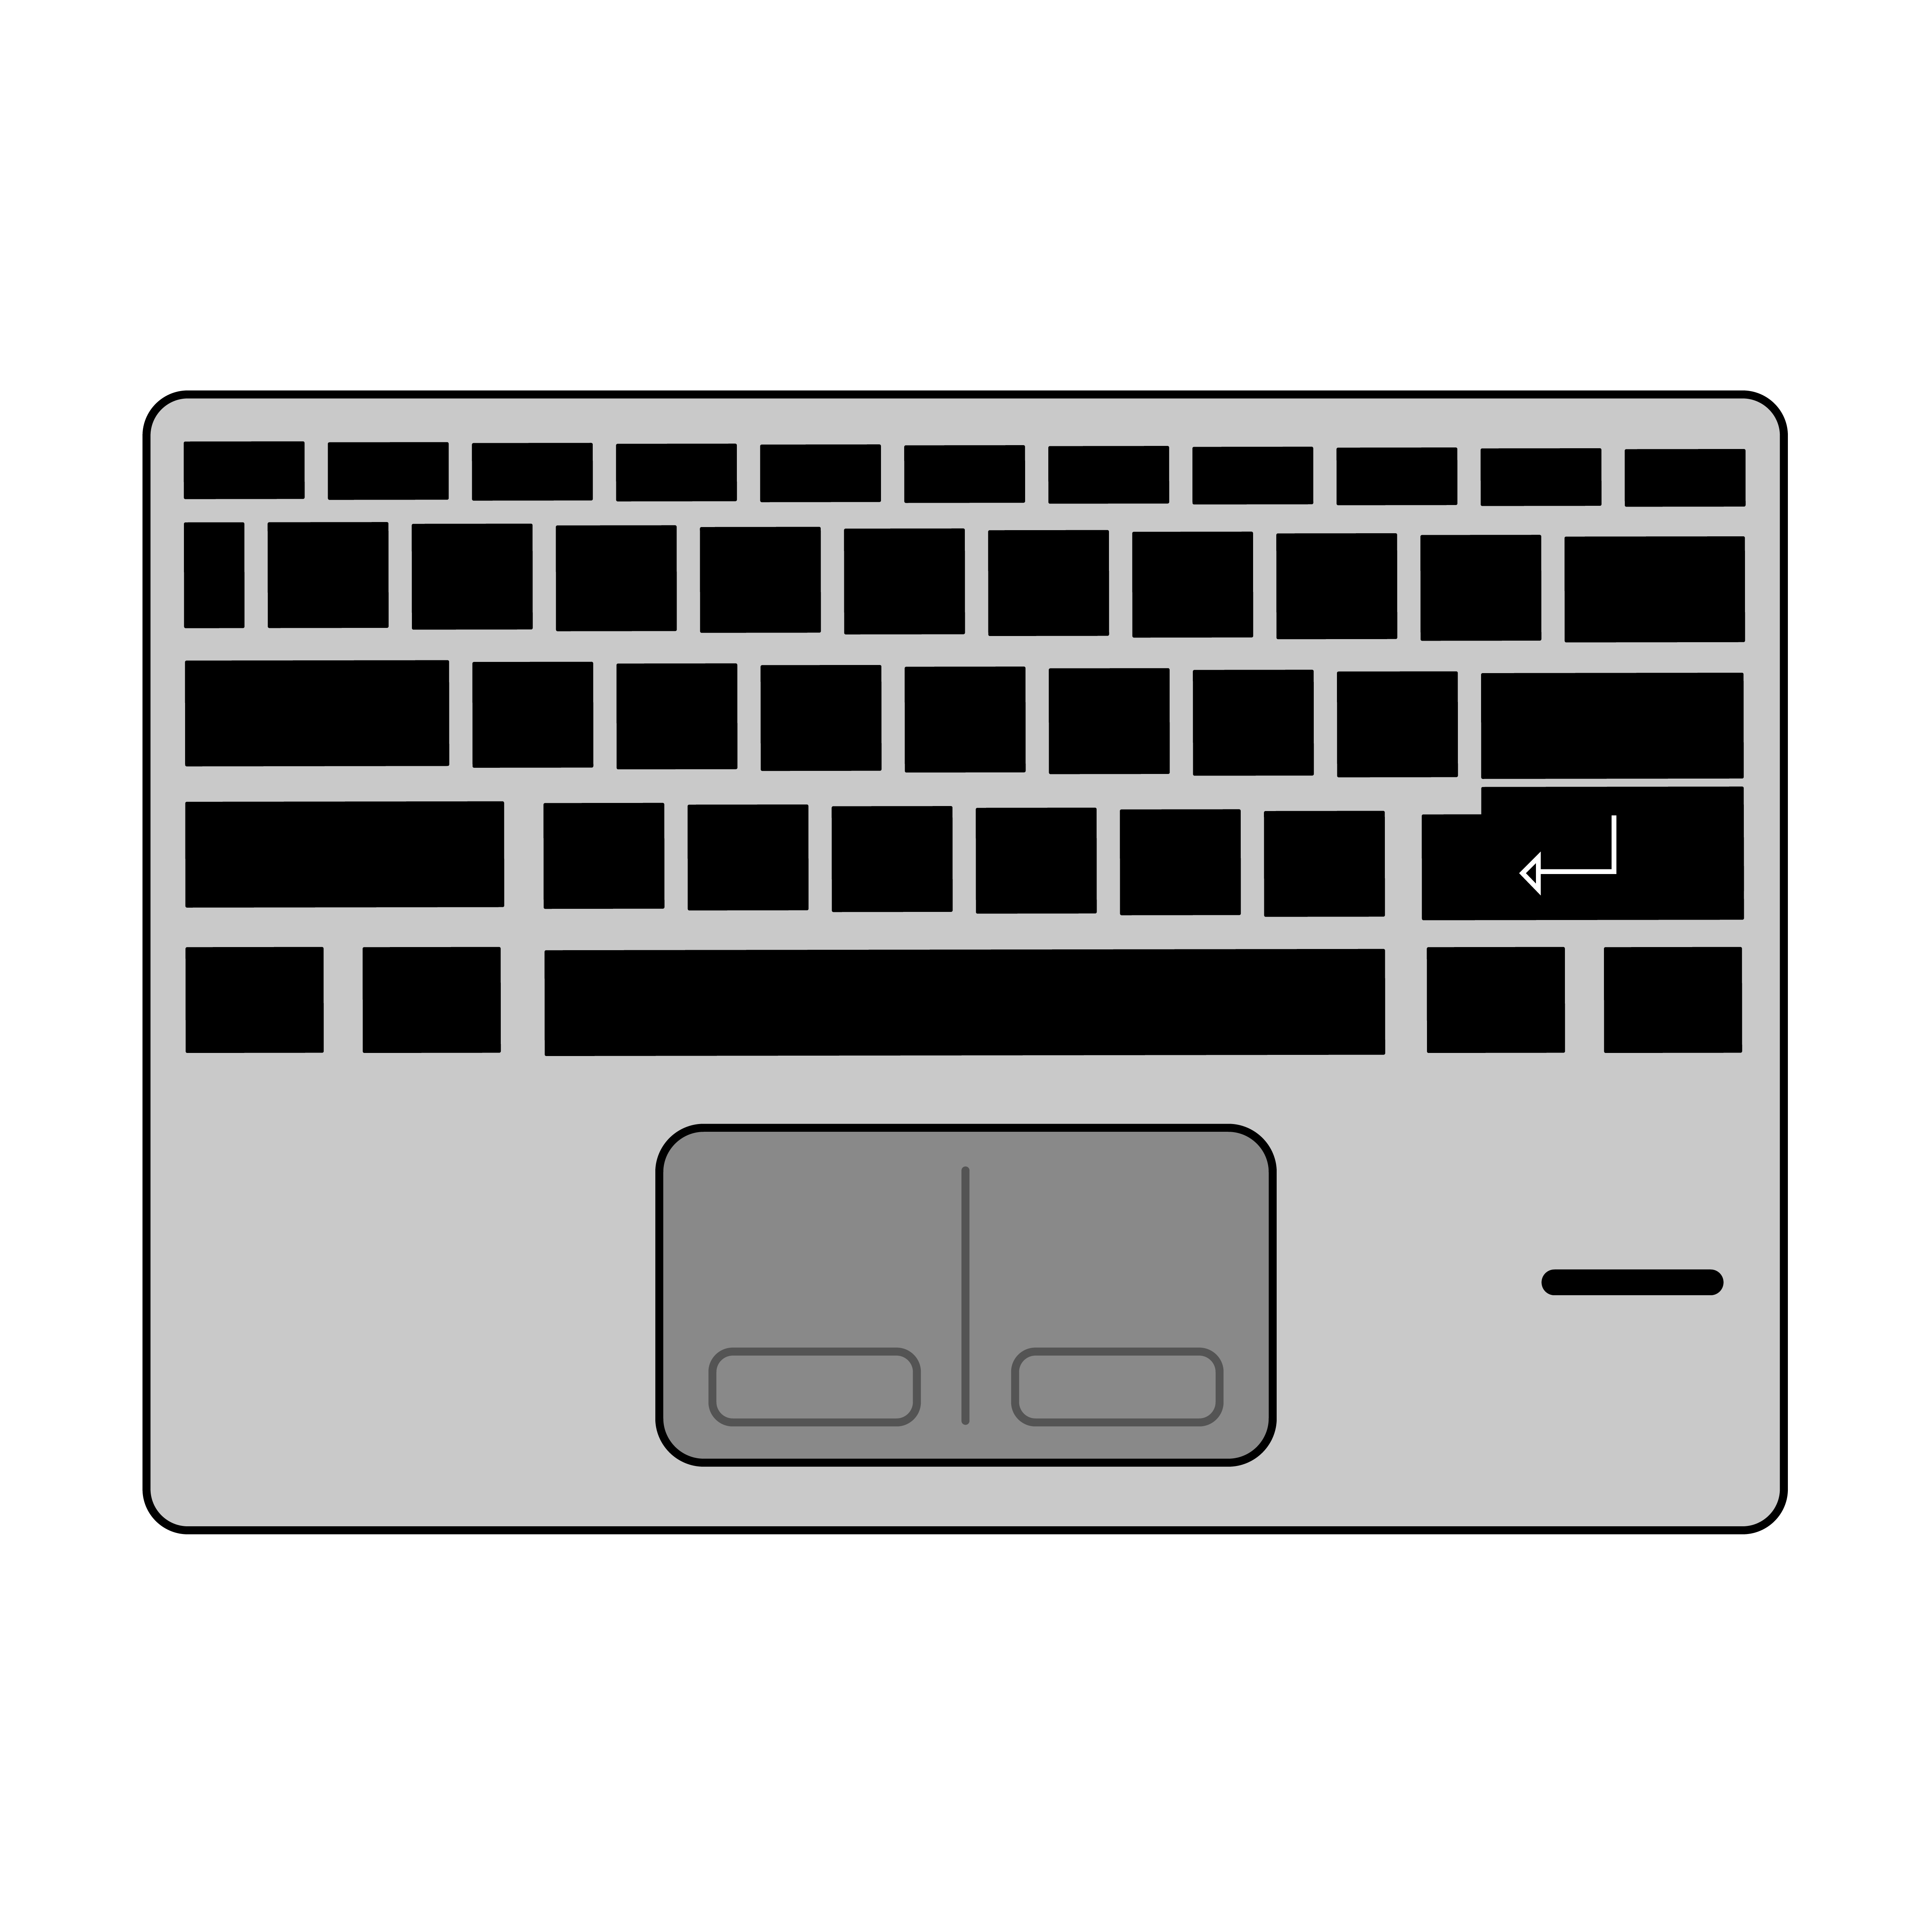
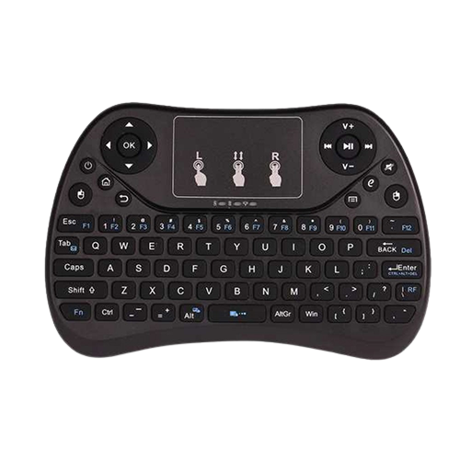
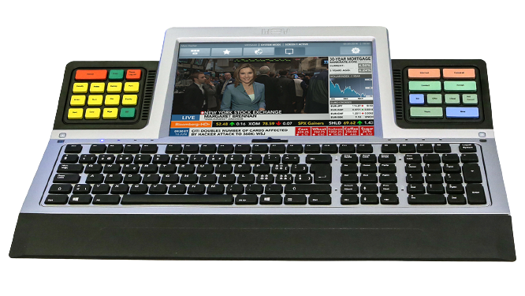
KEYBOARD
A keyboard is an input device that allows a person to enter symbols like letters and numbers into a computer.
It is the main input device for most computers. There are different types of keyboards.
The most popular type is the QWERTY desing such as typewriter keyboards.
01
LAPTOP KEYBOARD
02
HANDHELD KEYBOARD
03
MULTIFUNCTIONAL KEYBOARD
04
WIRELESS KEYBOARD

Slide 6
MOUSE
Mouse is the most popular point-and-draw device.
It is a must-have input device on modern personal computers.
Has 2 or 3 buttons and can be clicked or double-clicked to perform tasks.
Optical mouse doesn't have a ball but uses a laser tosense the motion.
MOUSE TYPES
SERIAL MOUSE
PS/2 MOUSE
OPTICAL MOUSE
WIRELESS MOUSE

Slide 7
SCANNER
Data scanning devices are input devices used for direct data entry into a computer system from source documents
Common scanner devices are
Magnetic Ink Character Recognition (MICR) reader
used by banks to process large volumes of cheques and drafts
Optical Mark Reader (OMR) scanner
scanning the answer sheet of an objective type test in which answers are marked by darkening a square or circle space by pencil
Optical Character Recognition (OCR) scanner
used for direct reading of any printed character
Barcode reader
used to read the barcodes printed on practically every item purchased from a department store

Slide 8
JOYSTICK
On most joysticks, a button on the top is provided to select the option currently pointed to by the cursor
A joystick is a pointing device that works on the principleof trackball
To make the movement of the spherical ball easier, it is placed in a socket with a stick mounted on it
Commonly used for controlling player movements in video or computer games

Slide 9
DIGITAL CAMERA
The digitized image of the object is matched against similarly formed pre-stored images in the computer's image database
The camera creates an image of the object in digital form so that It can be stored and interpreted by the computer
A computer with a vision-input device consists of digital camera

Slide 10
OUTPUT DEVICES
Information is retrieved from the computer system.

Slide 11
WHAT IS OUTPUT DEVICE
An output device is computer hardware that uses received data and commands from a computer in order to perform a task.
Any peripheral that receives data from a computer, usually for display, projection, or physical reproduction.
Computer hardware equipment used to communicate the results of data processing carried out by a computer to the outside world.

Slide 12
OUTPUT DEVICE TYPES
TEXT
GRAPHICS
TACTILE
VIDEO
AUDIO

Slide 13
MOST OUTPUT CAN BE DIVIDED INTO TWO CATEGORIES
SOFT COPY
HARD COPY

Slide 14
OUTPUT DEVICES
Speaker
Headphones
Screen (monitor)
Printer
Projector
Slotters

Slide 15
STORAGE DEVICES
Information is retrieved from the computer system.

Slide 16
WHAT EXACTLY IS A STORAGE DEVICE ?
Those devices which are used to store data, information and programs permanently.

Slide 17
TYPES OF STORAGE DEVICES
HARD DISK
FLOPPY DISK
OPTICAL DISK
FLASH MEMORY DRIVE
FLASH MEMORY DRIVE

Slide 18
OPTICAL DISK CATEGORIES
CD
DVD
BLU-RAY DISK

Slide 19
TYPES OF FLASH MEMORY STORAGE
Solid State Drives
USB Flash Drives
Memory Cards

Slide 20
PROCESSORS DEVICES
Information is retrieved from the computer system.

Slide 21
WHAT IS A PROCESSOR ?
The processor is the logic circuitry that responses and processes the basic instructions that drive the computer. The operations in the processor are, Simple binary computations using electrical circuits.

Slide 22
WHERE
The processor is placed on the motherboard, in the processor sockets.
On top of the processor we place the heat sink and the heat sink fan to dissipate heat from the processor.

Slide 23
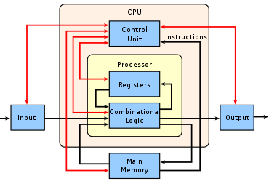
COMPONENTS
The processor itself is not made as a single unit but a series of units that work together to perform various operations.
Units of a processor
I/O unit
Control unit
ALU
Registers

Slide 24
COMPONENTS
There are five types of general purpose processors
Microcontroller
Microprocessor
Embedded Processor
DSP
Media Processor

Slide 25
THANK YOU

